Slide 1
Amortized Analysis
CS1236 – Lecture 2
Pranab Roy

Slide 2

Introduction
In computer science, amortized analysis is a method for analyzing a given algorithm's complexity, or how much of a resource, especially time or memory, it takes to execute.
The motivation for amortized analysis is that looking at the worst-case run time can be too pessimistic. Instead, amortized analysis averages the running times of operations in a sequence over that sequence.[
As a conclusion: "Amortized analysis is a useful tool that complements other techniques
such as worst-case and average-case analysis.
For a given operation of an algorithm, certain situations (e.g., input parametrizations or data structure contents) may imply a significant cost in resources,
whereas other situations may not be as costly.
The amortized analysis considers both the costly and less costly operations together over the whole sequence of operations.
This may include accounting for different types of input, length of the input, and other factors that affect its performance

Slide 3
Earlier Story
Amortized analysis initially emerged from a method called aggregate analysis,
The technique was first formally introduced by Robert Tarjan in his 1985 paper Amortized Computational Complexity,
The work addressed the need for a more useful form of analysis than the common probabilistic methods used.
Amortization was initially used for very specific types of algorithms, particularly those involving binary trees and union operations.
However, it is now ubiquitous and comes into play when analyzing many other algorithms as well.

Slide 4
Amortized Cost per Operation
The definition of amortized cost is actually quite simple:
The amortized cost per operation for a sequence of n operations is the total cost of the operations divided by n.
The reason for considering amortized cost is that we will be interested in data structures that occasionally can incur a large cost as they perform some kind of rebalancing or improvement of their internal state, but where such operations cannot occur too frequently.
For example, if we have 100 operations at cost 1, followed by one operation at cost 100, the amortized cost per operation is 200/101 < 2.

Slide 5
Examples
IMPLEMENTING A STACK AS AN ARRAY –
In this case, amortized analysis can give a much tighter bound on the true cost of using the data structure than a standard worst-case-per-operation bound.
Say we want to use an array to implement a stack.
We have an array A, with a variable top that points to the top of the stack (so A[top] is the next free cell).
• To implement push(x):
we just need to perform:
A[top] = x;
top++;
• To implement x=pop():
top--;
x = A[top]; (first checking to see if top==0 of course...)

Slide 6
Examples
However, what if the array is full and we need to push a new element on?
In that case we can allocate a new larger array, copy the old one over, and then go on from there.
This is going to be an expensive operation, so a push that requires us to do this is going to cost a lot.
But maybe we can “amortize” the cost over the previous cheap operations that got us to this point.
So, on average over the sequence of operations, we’re not paying too much.
To be specific, let us define the following cost model.
Cost model:
Let’s say that inserting into the array costs 1,
taking an element out of the array costs 1,
and the cost of resizing the array is the number of elements moved.

Slide 7
Cost of Operations
The aggregate method is used to find the total cost.
If we want to add a bunch of data, then we need to find the amortized cost by this formula.
For a sequence of n operations, the cost is −

Slide 8
Question 1: What if when we resize we just increase the size by 1?
Is that a good idea?
Answer 1: Not really. If our n operations consist of n pushes then we will incur a total cost
1 +2+3+4+...+n=n(n+1)/2.
That’s an amortized cost of (n+1)/2 per operation.
Question 2: What if we instead decide to double the size of the array when we resize?
Answer 2: This is much better.
Now, in any sequence of n operations, the total cost for resizing is 1 +2+4+8+...+2i for some 2i < n (if all operations are pushes then 2i will be the largest power of 2 less than n).
This sum is at most 2n − 1.
Adding in the additional cost of n for inserting/removing, we get a total cost < 3n, and so our amortized cost per operation is < 3.

Slide 9
Piggy banks and potential functions
Here is another way to analyze the process of doubling the array in the above example.
Say that every time we perform a push operation, we pay $1 to perform it, and we put $2 into a piggy bank. So, our out-of-pocket cost per push is $3.
Any time we need to double the array, from size L to 2L, we pay for it using money in the bank.
How do we know there will be enough money ($L) in the bank to pay for it?
The reason is that after the last resizing, there were only L/2 elements in the array and so there must have been at least L/2 new pushes since then contributing $2 each.
So, we can pay for everything by using an out-of-pocket cost of at most $3 per operation.
Putting it another way, by spending $3 per operation, we were able to pay for all the operations plus possibly still have money left over in the bank.
This means our amortized cost is at most 3.
This “piggy bank” method is often very useful for performing amortized analysis.
The piggy bank is also called a potential function, since it is like potential energy that you can use later. The potential function is a guarantee on the amount of money in the bank.
In the case above, the potential is twice the number of elements in the array after the midpoint.
Note that it is very important in this analysis to prove that the bank account doesn’t go negative.

Slide 10
Definition 7.2 A potential function is a function of the state of a system, that generally should be non-negative and start at 0, and is used to smooth out analysis of some algorithm or process.
Observation:
If the potential is non-negative and starts at 0, and at each step the actual cost of our algorithm plus the change in potential is at most c, then after n steps our total cost is at most cn.
That is just the same thing we were saying about the piggy bank: our total cost for the n operations is just our total out of pocket cost minus the amount in the bank at the end.
Sometimes one may need in an analysis to “seed” the bank account with some initial positive amount for everything to go through.
In that case, the kind of statement one would show is that the total cost for n operations is at most cn plus the initial seed amount.

Slide 11
Applications
Amortized Analysis is used for algorithms where an occasional operation is very slow, but most other operations are faster.
In Amortized Analysis, we analyze a sequence of operations and guarantee a worst-case average time that is lower than the worst-case time of a particularly expensive operation.
The data structures whose operations are analyzed using Amortized Analysis include:
Hash Tables
Disjoint Sets
Splay Trees
Amortized Analysis is a technique used in computer science to analyze the average-case time complexity of algorithms that perform a sequence of operations,
where some operations may be more expensive than others.
The idea is to spread the cost of these expensive operations over multiple operations so that the average cost of each operation remains constant or lower.

Slide 12
Applications
in a dynamic array, when resizing is required due to lack of space, the resizing operation is expensive.
However, its cost is amortized over several insertions, ensuring that the average time complexity of an insertion remains constant.
Amortized Analysis is useful for designing efficient algorithms for data structures such as:
Dynamic Arrays
Priority Queues
Disjoint-Set Data Structures
It ensures that the average-case time complexity of an operation remains constant, even if some operations are expensive.

Slide 13
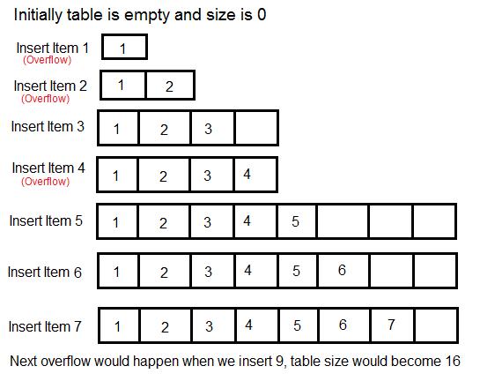
Amortized Analysis of Hash Table Insertions
Choosing the Table Size
When designing a hash table, we must decide on the table size.
There is a trade-off between space and time. If the hash table size is large, search time becomes low, but the space required increases.

Slide 14
The solution to this trade-off problem is to use Dynamic Table (or Arrays).
The idea is to increase the size of the table whenever it becomes full.
Allocate memory for larger table size, typically twice the old table.
Copy the contents of the old table to a new table.
Free the old table.
If the table has space available, we simply insert a new item in the available space.
.

Slide 15
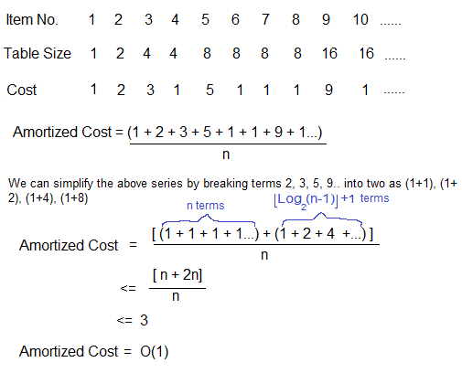
What is the time complexity of n insertions using the above scheme?
If we use simple analysis, the worst-case cost of insertion is O(n).
Therefore, the worst-case cost of n inserts is n * O(n) which is O(n²).
This analysis gives an upper bound, but not a tight upper bound for n insertions as all insertions don't take Θ(n) time.
So, using Amortized Analysis, we could prove that the Dynamic Table scheme has O(1) insertion time which is a great result used in hashing.
Also, the concept of the dynamic table is used in vectors in C++ and ArrayList in Java.

Slide 16
Amortized Analysis – Different Methods
Amortized cost of a sequence of operations can be seen as expenses of a salaried person.
The average monthly expense of the person is less than or equal to the salary, but the person can spend more money in a particular month by buying a car or something.
In other months, he or she saves money for the expensive month.
The previous Amortized Analysis was done for Dynamic Array example is called Aggregate Method.
There are two more powerful ways to do Amortized analysis called
Accounting Method
Potential Method.

Slide 17
Accounting Method
The accounting method of amortized analysis can be useful for understanding the performance of algorithms that perform a sequence of operations with varying costs.
It can be applied to a wide range of data structures and algorithms.
To solve a problem using amortized analysis using the accounting method, these steps are followed:
Identify the sequence of operations that the algorithm will perform, and determine which operations are "cheap" and which are "expensive."
Cheap operations are those that require less time or resources than the average operation, while expensive operations are those that require more time or resources.
Define a credit or potential function that will be used to track the credit that has been accumulated by the algorithm.

Slide 18
Accounting Method
This function should assign a credit value to the state of the data structure at each point in time.
Initialize the credit to 0.
For each operation in the sequence, do the following:
If the operation is cheap, increment the credit by the cost of the operation.
If the operation is expensive, subtract the credit from the cost of the operation to determine the actual cost. The actual cost is the difference between the cost of the operation and the credit.
If the credit becomes negative, reset it to 0.
At the end of the sequence, divide the total cost by the number of operations to determine the average cost per operation.

Slide 19
The Bankers Method
This is a more general and powerful method of amortized analysis than the aggregate method
It allows to assign different costs to different operations,
but in exchange, it requires more reserve to use.
In the bankers method, each operation has an actual cost as specified by the cost model,
and additionally may choose to pay an extra cost (a credit) to store in the data structure for later use.
A future operation may use this credit to offset the cost of an expensive operation.
The amortized cost of an operation is its actual cost in the cost model, plus any credit it pays for, minus the value of any previous credit that it consumes.

Slide 20
The Bankers Method (Contd.)
We will use the following charging scheme:
Whenever we insert a new element into the list, we will pay a credit of 2 and leave it on the list element. Therefore, the cost of an insertion not counting any resizing operation is 3.
Now consider what happens when a resizing operation is triggered.
The array must be full (c = n),
and the final half of the elements (n/2 of them) will each possess an unused credit of 2.
Therefore, there is a credit of n in the data structure.
We consume this credit to pay for the cost of moving the n elements to the freshly allocated array (which costs exactly n),
So, the amortized cost of the resizing procedure is zero.
Therefore,
the amortized cost of any append operation, whether it triggers a resizing or not is always 3

Slide 21
Accounting Method: Example
Consider the previous algorithm that performs a series of insertions into a dynamic array.
Each insertion is fast, but if the array becomes full, the algorithm must perform a slower operation to resize the array and make room for the new insertion.
We want to use amortized analysis to determine the average cost per insertion.
Identify the sequence of operations:
Each insertion is a cheap operation, and the resize operation is an expensive operation.
Define a credit function: We can define the credit function as follows:
If we insert a new value – cost is 1 and credit is 2 – total investment is 3
If the array is resized – cost = cost of inserting the old values[spend the credit for that]+ cost of insertion of new element =1 + new credit = 2
If the credit goes to be negative – initialize it to zero.

Slide 22
Perform the operations:
Insertion 1: Cost = 1 Credit = 2
Insertion 2:
Array is full, must resize Cost = 2 Credit = 3
Insertion 3: Array is full, must resize Cost = 3 Credit = 3
Insertion 4: Cost = 1 Credit = 5
Insertion 5:
Array is full, must resize Cost = 5 Credit = 3
Calculate the average cost per operation:
To calculate the average cost per operation, we sum the total cost and divide by the number of operations.
In this example, the total cost is 8 and the number of operations is 5, so the average cost per operation is 12/5 = 2.4.
This average cost per operation reflects the fact that some insertions have a lower cost due to the credit accumulated through previous cheap operations, while other insertions have a higher cost due to the expensive resize operation.

Slide 23
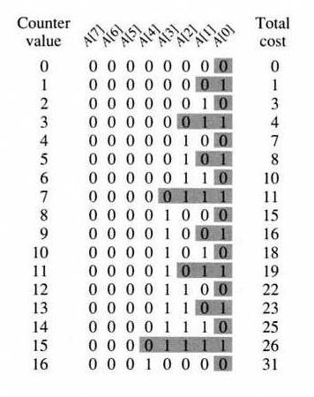
Example 2: a binary counter
Imagine we want to store a big binary counter in an array A.
All the entries start at 0 and at each step we will be simply incrementing the counter.
our cost model is:
whenever we increment the counter, we pay $1 for every bit we need to flip.
(So, think of the counter as an array of heavy stone tablets, each with a “0” on one side and a “1” on the other.)

Slide 24
In a sequence of n increments, the worst-case cost per increment is O(n), since at worst we flip
n bits.
But, what is our amortized cost per increment? The answer is it is at most 2. Here are two proofs.
Proof 1:
Every time you flip 0 → 1, pay the actual cost of $1, plus put $1 into a piggy bank.
So the total amount spent is $2.
In fact, think of each bit as having its own bank
(so when you turn the stone tablet from 0 to 1, you put a $1 coin on top of it).
Now, every time you flip a 1 → 0, use the money in the bank (or on top of the tablet) to pay for the flip.
Clearly, by design, our bank account cannot go negative.
The key point now is that even though different increments can have different numbers of 1 → 0 flips, each increment has exactly one 0 → 1 flip. So, we just pay $2 (amortized) per increment.
Equivalently, what we are doing in this proof is using a potential function that is equal to the number of 1-bits in the current count.

Slide 25
Proof 2:
Here is another way to analyze the amortized cost.
First, how often do we flip A[0]?
Answer: every time.
How often do we flip A[1]?
Answer: every other time.
How often do we flip A[2]?
Answer: every 4th time, and so on.
So, the total cost spent on flipping A[0] is n,
the total cost spent flipping A[1] is at most n/2,
the total cost flipping A[2] is at most n/4, etc.
Summing these up, the total cost spent flipping all the positions in our n increments is at most 2n.

Slide 26
The Potential Method
The banker's method is a nice improvement over the aggregate method since it can be used to analyze trickier data structures, or data structures with different costs per operation.
We can do even better with an even more general method called the potential method.
In the potential method, we define a potential function Φ,
This maps a data structure state S to a real number Φ(S).
We will often use the notation S_{i} to denote the state of the data structure after applying the ith operation,
and S₀ to denote the initial state of the data structure.
Consider a sequence of m operations σ1, σ2, . . . , σm on the data structure.
Let the sequence of states through which the data structure passes be S0, S1, . . . , Sm.
Notice that operation σ_{i} changes the state from S_{i−1} to S_{i}.
Let the actual cost of operation σi in the cost model be c_{i}.
Given a potential function Φ, we define the amortized cost ac_{i} of operation σ_{i} by the following formula:
ac_{i} = c_{i} + Φ(S_{i}) − Φ(S_{i−1}),

Slide 27
The Potential Method
we can describe the amortized cost as
(amortized cost) = (actual cost) + (change in potential).
If an operation pays a credit of p, we can consider that as equivalent to increasing the potential by p.
If an operation consumes p credits, we can consider that as the same as decreasing the potential by p.
With this correspondence, we can observe that the amortized cost defined by the potential method is the same as the amortized cost defined by the banker’s method.
This depicts that the potential method is indeed a generalization of the banker’s method.
Returning to the general potential method, if we sum up the amortized costs of a sequence of operations,
we obtain the following formula:

Slide 28
The Potential Method
The Φ(Si) terms all appeared once as a positive and once as a negative,
So, they all canceled out, except for the first and last terms which each only appeared once.
Rearranging we get
If Φ(S0) ≤ Φ(Sn) (as will frequently be the case) we get
Thus, if we can bind the amortized cost of each of the operations, and the final potential is at least as large as the initial potential, then the total amortized cost is indeed an upper bound on the total actual cost,
or, the average actual cost is at most the average amortized cost.
It is very common (but not required) to define our potential functions such that Φ(S0) = 0 and Φ(Si) ≥ 0 for all i.

Slide 29
Randomized Analysis
The amortized analysis doesn't involve probability.
There is also another different notion of average-case running time where algorithms use randomization to make them faster and the expected running time is faster than the worst-case running time.
These algorithms are analyzed using Randomized Analysis. Examples of these algorithms are Randomized Quick Sort, Quick Select and Hashing.
Randomized analysis of algorithms involves analyzing the behavior of algorithms that incorporate randomness into their logic or input.
This differs from deterministic algorithms, which follow a fixed procedure to produce the same output for the same input every time.
Randomized algorithms use random bits or inputs to influence the algorithm's steps or decisions, potentially leading to improved efficiency or simpler design compared to deterministic approaches.

Slide 30
Randomized Analysis
Randomness in Algorithms:
Randomness can be introduced in various ways, such as:
Random Pivot Selection: In quicksort, choosing a random element as a pivot can prevent worst-case scenarios.
Random Sampling: Randomly selecting a subset of data can be used for approximation or to speed up computations.
Randomized Decisions: Making decisions based on random coin flips or other random number generation.
Types of Randomized Algorithms:
Las Vegas Algorithms: Always produce the correct answer, but the running time may vary depending on the random choices.
Monte Carlo Algorithms: May produce incorrect results with a certain probability, but they are often faster.

Slide 31
Why Use Randomized Algorithms?
Improved Efficiency:
Randomization can lead to better average-case performance than deterministic algorithms for certain problems.
Simpler Design:
Randomized algorithms can sometimes be easier to design and implement than deterministic ones.
Breaking Symmetry:
Randomization can help break ties or symmetries that might lead to poor performance in deterministic algorithms.
Handling Uncertainties:
Randomized algorithms can be useful when dealing with uncertain or probabilistic data.

Slide 32
Analysis of Randomized Algorithms:
Expected Value Analysis:
Analyzing the average behavior of the algorithm over all possible random choices.
Probabilistic Analysis:
Analyzing the probability of the algorithm producing a correct answer or achieving a certain performance level.
Worst-Case Analysis (with probability bounds):
Analyzing the worst-case behavior of the algorithm, but with probabilities associated with these worst-case scenarios.

Slide 33
Thank You

